Slide 1
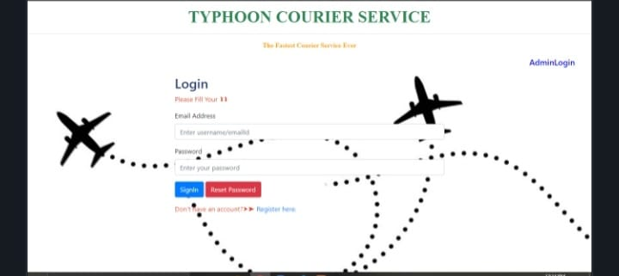
COURIER MANAGEMENT SYSTEM CA 2 DBMS
SUBMITTED BY::Unnati Bhargava

Slide 2
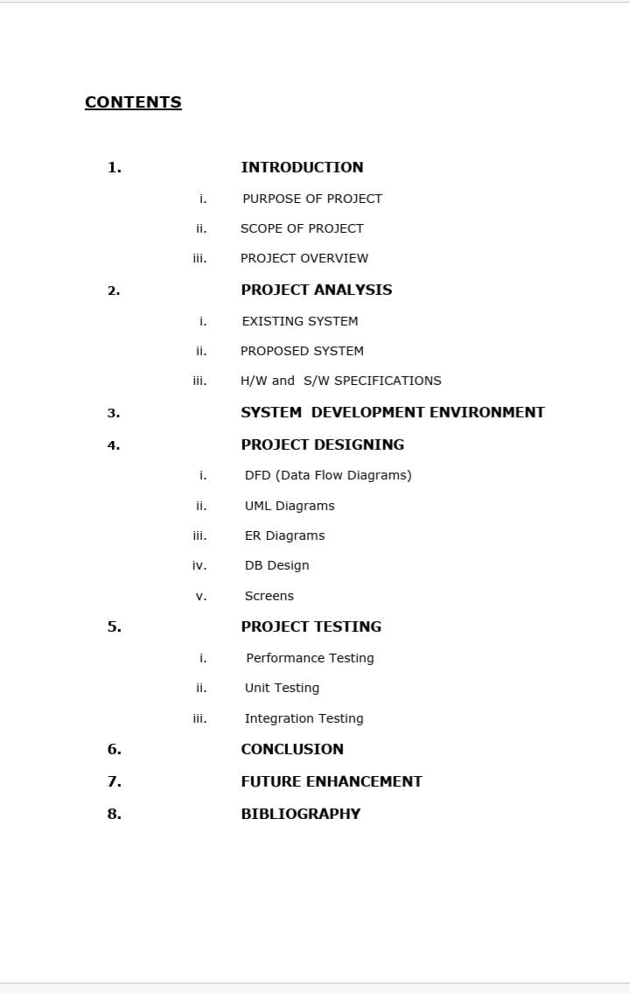


Slide 3
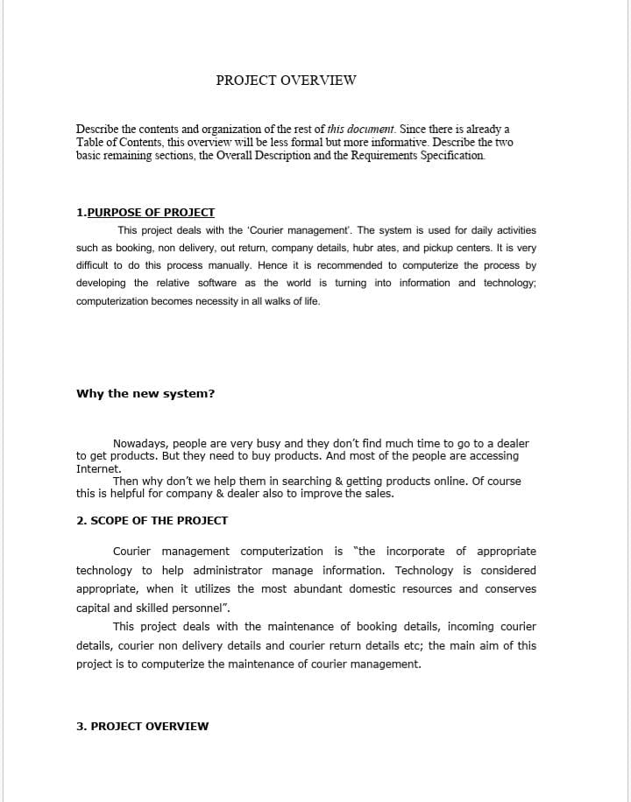

Slide 4
PROJECT OVERVIEW Describe the contents and organization of the rest of this document. Since there is already a Table of Contents, this overview will be less formal but more informative. Describe the two basic remaining sections, the Overall Description and the Requirements Specification. 1.PURPOSE OF PROJECT This project deals with the ‘Courier management’. The system is used for daily activities such as booking, non delivery, out return, company details, hubrates, and pickup centers. It is very difficult to do this process manually. Hence it is recommended to computerize the process by developing the relative software as the world is turning into information and technology; computerization becomes necessity in all walks of life. Why the new system? Nowadays, people are very busy and they don’t find much time to go to a dealer to get products. But they need to buy products. And most of the people are accessing Internet. Then why don’t we help them in searching & getting products online. Of course this is helpful for company & dealer also to improve the sales. 2. SCOPE OF THE PROJECT Courier management computerization is “the incorporate of appropriate technology to help administrator manage information. Technology is considered appropriate, when it utilizes the most abundant domestic resources and conserves capital and skilled personnel”. This project deals with the maintenance of booking details, incoming courier details, courier non delivery details and courier return details etc, the main aim of this project is to computerize the maintenance of courier management.

Slide 5
3. PROJECT OVERVIEW Module Description: Administrator Courier Courier module contains bookings, incomings, out returns, no delivery, hub rates, and pickup centers details. The following are the forms that exist in this module Booking Form Incoming Form Non delivery Form Out returns Form Hub rates form Company details Form Pickup centers Form Booking form contains different text fields, option buttons, list boxes and buttons to enter the details about the source address, destination address, weight, amount details. Incoming form contains the details like source address and destination address the date of delivery. Non delivery form contains the details like forward date, in date, source address and destination address.

Slide 6
Employee
This module deals with the details about the employees who are working in the organization and their payroll details
The following are the forms that exist in this module
Employee details form
payroll form
Employee form contains the different text fields, list boxes and buttons to enter the details like employee number, name, and address, date of join, assigned area, and phone number.
Payroll form deals details like employee number, name, incentives, advances, net salary.

Slide 7
Bottlenecks of the existing system The existing system has lot of problems such as The entire database is maintained manually which is rather tedious and error prone Time delay is more because of verification of many records for generating reports, answering querier etc. Queries are not answered properly due to lack of communication. More space is required to keep all the records. Improper interface.

Slide 8
SYSTEM DEVELOPMENT ENVIRONMENT 1.HTML WHAT IS HTML? To publish information for global distribution, one needs a university-understood language, a kind of publishing mother tongue that all computers may potentially understand. The publishing language used by the World Wide Web is HTML (Hyper Text Markup Language) HTML Gives Authors The Means To 1.Publish online documents with headings, text, tables, list, photos etc. 2.Retrieve online information via hypertext links, at the click of a button 3.Design forms for conducting transactions with remote services, for use in searching information, making reservation, ordering products etc.; 4.Includes spreadsheets, video clips, sound clips, and other applications directly in the documents.

Slide 9
Some HTML Tags <HTML> :Starting an HTML tag <HEAD> : Creating a web page’s head <TITLE> : Giving a web page ‘s body </HEAD> : Ending a web pages head </BODY> : Ending a web pages body </HTML> :Ending a web page <FORM> : Creating a HTML forms

Slide 10
<INPUT TYPE=BUTTON> : Creating a buttons <INPUT TYPE=CHECKBOX> : Creating a checkboxes <INPUT TYPE=SUBMIT> : Creating a submit button <INPUT TYPE=TEXT> : Creating a text fields HTML 4.0 HTML 4.0 extends with mechanisms for style sheets, scripting, frames embedding objects, improved support for right to left and mixed direction texts, richer tables and enhancements to form, offering improved accessibilities for people with disability.

Slide 11
2. INTRODUCTION TO JAVA SCRIPT WHAT IS JAVA SCRIPT? JavaScript, originally supported by Netscape Navigator, is the most popular Web scripting language today. JavaScript lets you embed programs right in your Web pages and run these programs using the Web browser. You place these programs in a <SCRIPT> element. If you want the script to write directly to the Web page, place it in the <BODY> element. EX: <HTML> <HEAD> <TITLE></TITLE> </HEAD> <BODY> <SCRIPT LANGUAGE=”JavaScript”> </SCRIPT> </BODY></HTML> JAVASCRIPTS OBJECTS

Slide 12
JAVASCRIPTS OBJECTS JavaScript is an object-oriented language. JavaScript comes with a number of predefined objects. Objects of the JavaScript Document: Corresponds to the current Web page’s body. Using this object, you have access to the HTML of the page itself, including the all links, images and anchors in it. Form: Holds information about HTML forms in the current page. Frame: Refers to a frame in the browser’s window. History: Holds the records of sites the Web browser has visited before reaching the current page. Location: Holds information about the location of the current web page. Navigator: Refers to the browser itself, letting you determine what browser the user has. Window: Refers to the current browser window. JAVASCRIPTS EVENTS Some of the events of JavaScript 1.on Change: Occurs when data in a control, like a text field, changes. 2.on Click: Occurs when an element is clicked.

Slide 13
3.on Focus: Occurs when an element gets the focus. 4.on Mouse Down: Occurs when a mouse button goes down. 5.on Reset: Occurs when the user clicks the reset button. JAVASCRIPTS FUNCTIONS Declaration of function Syntax: function function name () { … … } Write these functions in <SCRIPT> tag

Slide 14
. INTRODUCTION ABOUT .NET Overview of the .NET Framework The .NET Framework is a new computing platform that simplifies application development in the highly distributed environment of the Internet. The .NET Framework is designed to fulfill the following objectives: To provide a consistent object-oriented programming environment whether object code is stored and executed locally, executed locally but Internet-distributed, or executed remotely. To provide a code-execution environment that minimizes software deployment and versioning conflicts. To provide a code-execution environment that guarantees safe execution of code, including code created by an unknown or semi-trusted third party. To provide a code-execution environment that eliminates the performance problems of scripted or interpreted environments.

Slide 15
To make the developer experience consistent across widely varying types of applications, such as Windows-based applications and Web-based applications. To build all communication on industry standards to ensure that code based on the .NET Framework can integrate with any other code. The .NET Framework has two main components: the common language runtime and the .NET Framework class library. The common language runtime is the foundation of the .NET Framework. You can think of the runtime as an agent that manages code at execution time, providing core services such as memory management, thread management, and remoting, while also enforcing strict type safety and other forms of code accuracy that ensure security and robustness. In fact, the

Slide 16
the concept of code management is a fundamental principle of the runtime. Code that targets the runtime is known as managed code, while code that does not target the runtime is known as unmanaged code. The class library, the other main component of the .NET Framework, is a comprehensive, object-oriented collection of reusable types that you can use to develop applications ranging from traditional command-line or graphical user interface (GUI) applications to applications based on the latest innovations provided by ASP.NET, such as Web Forms and XML Web services.

Slide 17
The .NET Framework can be hosted by unmanaged components that load the common language runtime into their processes and initiate the execution of managed code, thereby creating a software environment that can exploit both managed and unmanaged features. The .NET Framework not only provides several runtime hosts, but also supports the development of third-party runtime hosts. For example, ASP.NET hosts the runtime to provide a scalable, server-side environment for managed code. ASP.NET works directly with the runtime to enable Web Forms applications and XML Web services, both of which are discussed later in this topic.

Slide 18
The common language runtime manages memory, thread execution, code execution, code safety verification, compilation, and other system services. These features are intrinsic to the managed code that runs on the common language runtime. With regards to security, managed components are awarded varying degrees of trust, depending on a number of factors that include their origin (such as the Internet, enterprise network, or local computer). This means that a managed component might or might not be able to perform file-access operations, registry-access operations, or other sensitive functions, even if it is being used in the same active application. The runtime enforces code access security. For example, users can trust that an executable embedded in a Web page can play an animation on screen or sing a song, but cannot access their personal data, file system, or network. The security features of the runtime thus enable legitimate Internet-deployed software to be exceptionally feature rich.

Slide 19
The runtime also enforces code robustness by implementing a strict type- and code-verification infrastructure called the common type system (CTS). The CTS ensures that all managed code is self-describing. The various Microsoft and third-party language compilers generate managed code that conforms to the CTS. This means that managed code can consume other managed types and instances, while strictly enforcing type fidelity and type safety. In addition, the managed environment of the runtime eliminates many common software issues. For example, the runtime automatically handles object layout and manages references to objects, releasing them when they are no longer being used. This automatic memory management resolves the two most common application errors, memory leaks and invalid memory references.

Slide 20
The runtime also accelerates developer productivity. For example, programmers can write applications in their development language of choice, yet take full advantage of the runtime, the class library, and components written in other languages by other developers. Any compiler vendor who chooses to target the runtime can do so. Language compilers that target the .NET Framework make the features of the .NET Framework available to existing code written in that language, greatly easing the migration process for existing applications. While the runtime is designed for the software of the future, it also supports software of today and yesterday. Interoperability between managed and unmanaged code enables developers to continue to use necessary COM components and DLLs.

Slide 21
The runtime is designed to enhance performance. Although the common language runtime provides many standard runtime services, managed code is never interpreted. A feature called just-in-time (JIT) compiling enables all managed code to run in the native machine language of the system on which it is executing. Meanwhile, the memory manager removes the possibilities of fragmented memory and increases memory locality-of-reference to further increase performance. Finally, the runtime can be hosted by high-performance, server-side applications, such as Microsoft® SQL Server™ and Internet Information Services (IIS). This infrastructure enables you to use managed code to write your business logic, while still enjoying the superior performance of the industry's best enterprise servers that support runtime hosting.

Slide 22
Common Type System
The common type system defines how types are declared, used, and managed in the runtime, and is also an important part of the runtime's support for cross-language integration.
Language Interoperability
Describes built-in support for cross-language interoperability and introduces the Common Language Specification.
What is the Common Language Specification?
Explains the need for a set of features common to all languages and identifies CLS rules and features.
Writing CLS-Compliant Code
Discusses the meaning of CLS compliance for components and identifies levels of CLS compliance for tools.
Common Type System
Describes how types are declared, used, and managed by the common language runtime.

Slide 23
Metadata and Self-Describing Components Explains the common language runtime's mechanism for describing a type and storing that information with the type itself. . NET Framework Class Library The .NET Framework class library is a collection of reusable types that tightly integrate with the common language runtime. The class library is object oriented, providing types from which your own managed code can derive functionality. This not only makes the .NET Framework types easy to use, but also reduces the time associated with learning new features of the .NET Framework. In addition, third-party components can integrate seamlessly with classes in the .NET Framework.

Slide 24
. In addition to these common tasks, the class library includes types that support a variety of specialized development scenarios. For example, you can use the .NET Framework to develop the following types of applications and services: Console applications. Scripted or hosted applications. Windows GUI applications (Windows Forms). ASP.NET applications. XML Web services. Windows services. Client Application Development Client applications are the closest to a traditional style of application in Windows-based programming. These are the types of applications that display windows or forms on the desktop, enabling a user to perform a task. Client applications include applications such as word processors and spreadsheets, as well as custom business applications such as data-entry tools, reporting tools, and so on.

Slide 25
Managed Execution Process The managed execution process includes the following steps: Choosing a Complier To obtain the benefits provided by the common language runtime, you must use one or more language compilers that target the runtime. Compiling your code to Microsoft Intermediate Language (MSIL) Compiling translates your source code into MSIL and generates the required metadata. Compiling MSIL to native code At execution time, a just-in-time (JIT) compiler translates the MSIL into native code. During this compilation, code must pass a verification process that examines the MSIL and metadata to find out whether the code can be determined to be type safe. Executing your code The common language runtime provides the infrastructure that enables execution to take place as well as a variety of services that can be used during execution.

Slide 26
5.RDBMS CONCEPTS DATA ABSTRACTION A major purpose of a database system is to provide users with an abstract view of the data. This system hides certain details of how the data is stored and maintained. However in order for the system to be usable, data must be retrieved efficiently. The efficiency lead to the design of complex data structure for the representation of data in the database. Certain complexity must be hidden from the database system users. This accomplished by defining several levels of abstraction at which the database may be viewed. CLASSIFICATION OF DATABASE There are 3 types of database approaches given below,

Slide 27
Hierarchical Database: In this type of model data is represented in simple tree structured. The record at the top of three is known as root, the root may have any number of dependents. Each of these may have any number of low level dependents and so on up to any number of levels. The disadvantages of the approach are that no independent record occurrence can exist without it’s superior. A.Network Database: In a Network database, data is represented by Network structure. In this approach record occurrence can have any number of superiors as well as any number of immediate dependents thus allow many to many correspondence directly than an hierarchical approach. The main disadvantage of the Network model is data representation is very complex resulting in complexity of the DML (Data Manipulation Language). b.Relational Database: The Relational model represents data and relationships among data by a collection of tables each of which has a number of columns with unique names.

Slide 28
6.THE SQL LANGUAGE SQL is a language for relational database. SQL is a non-procedural i.e., when we use SQL we specify what we want to be done not how to do it. Features Of SQL SQL is an interactive query language. SQL is a database administration language. SQL is a database programming language. SQL is a client/server language. SQL is a distributed database language. SQL is a database gateway language. Basic SQL Commands Data Definition Language commands (DDL) Data Manipulation Language commands (DML) Transaction Control Language commands (TCL) Data control Language commands (DCL)

Slide 29
DFD:: LEVEL-0: SYSTEM INPUT/OUTPUT LEVEL A level-0 DFD describes the system-wide boundaries, dealing inputs to and outputs from the system and major processes. This diagram is similar to the combined user-level context diagram. LEVEL-1: SUBSYSTEM LEVEL DATA FLOW A level-1 DFD describes the next level of details within the system, detailing the data flows between subsystems, which makeup the whole. LEVEL-2: FILE LEVEL DETAIL DATA FLOW All the projects are feasible given unlimited resources and infinite time. It is both necessary and prudent to evaluate the feasibility of the project at the earliest possible time. Feasibility and the risk analysis are pertained in many ways. If project risk is great. FIRST LEVEL DTAFLOW DIAGRAM

Slide 30
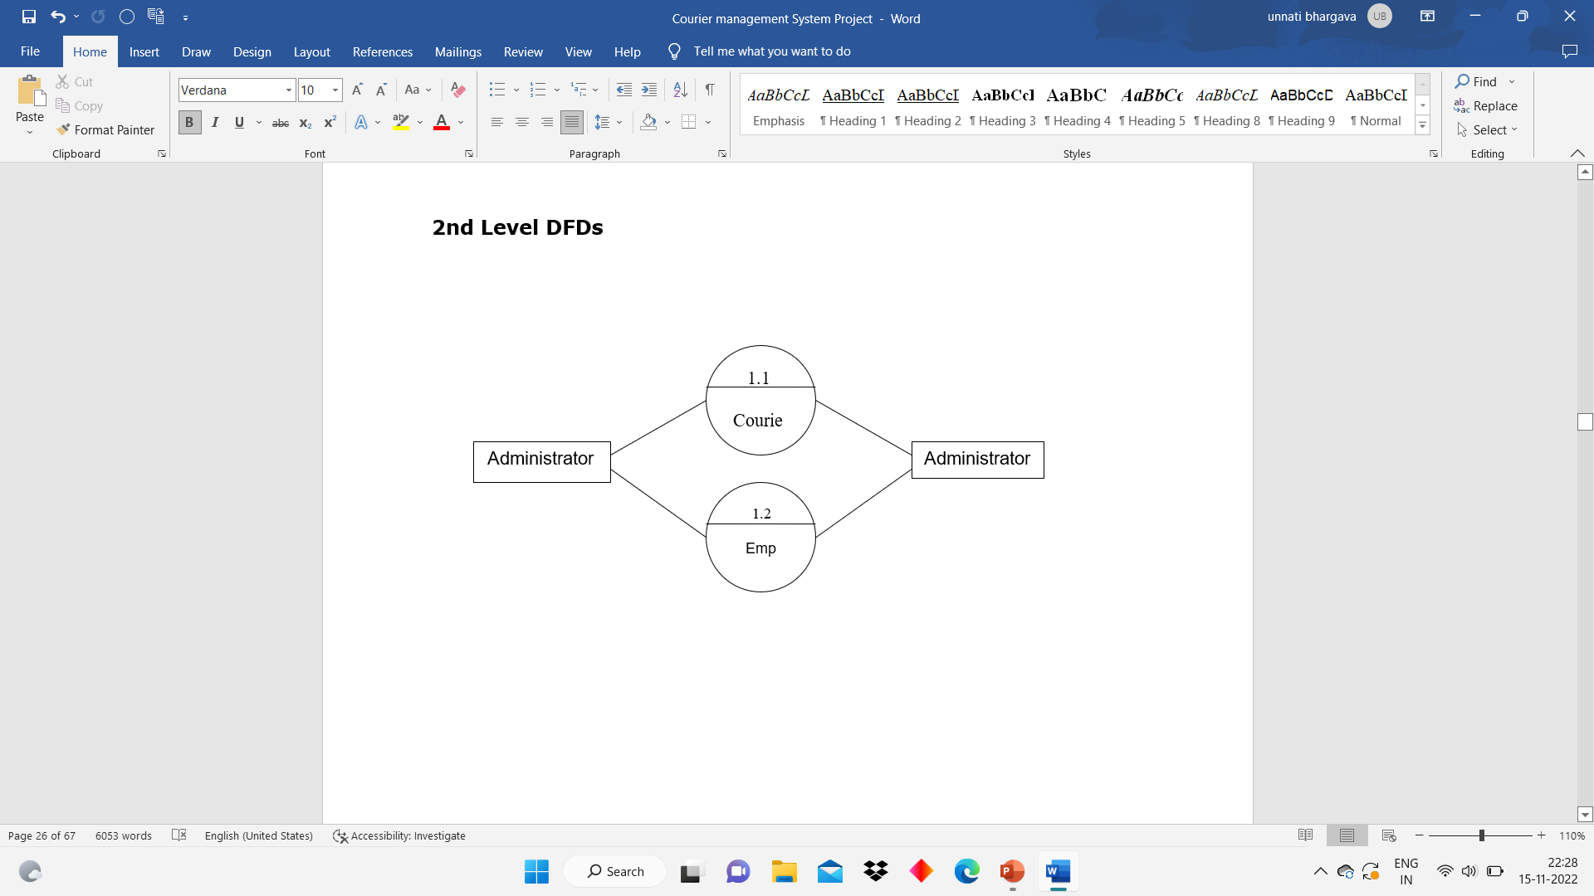
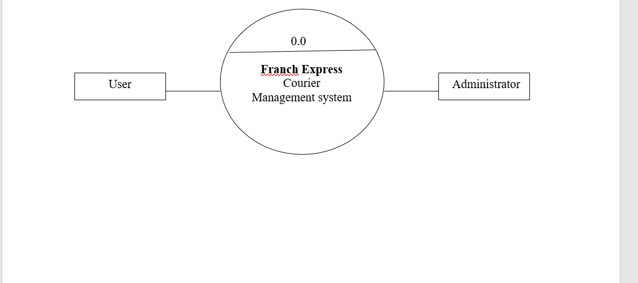

Slide 32
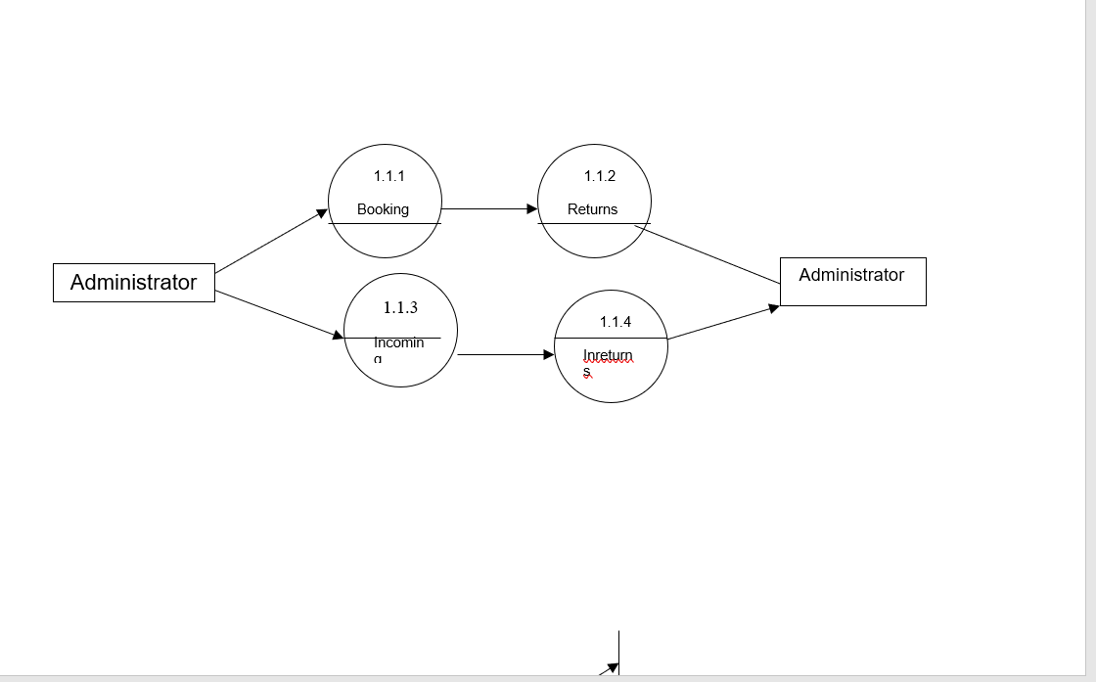

Slide 33
